Slide 1
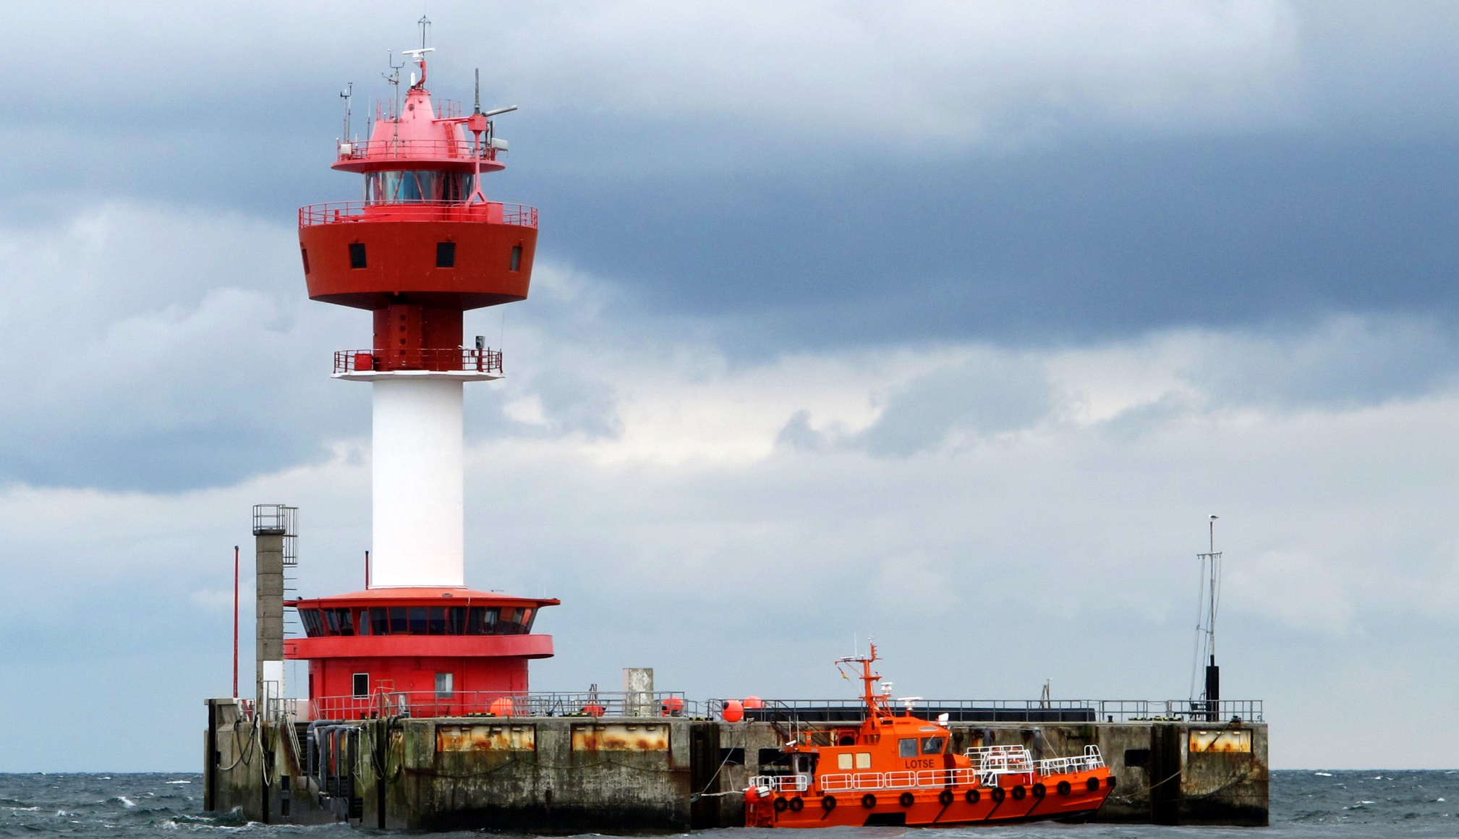
Final Presentation
Hybrid-MLWP: Enhancing Numerical Weather Prediction (NWP)
February 5th, 2026

Slide 2
Idea: Transformer-based Next Token Prediction
15°C
17°C
18°C
16°C
17°C
18°C
20°C
19°C
20°C
15°C
17°C
18°C
16°C
17°C
18°C
20°C
19°C
20°C
21°C
15°C
17°C
18°C
16°C
17°C
18°C
20°C
19°C
20°C
21°C
22°C
Temperatures are only used by way of example
The actual model will focus on wind forecasts using
zonal wind (W→E),
meridional wind (N→S) and
mean sea-level pressure
Use the attention mechanism to predict the next state and progress the prediction in an auto-regressive manner

Slide 3
Expectation
Weather is a highly non-local process
Only relying on the past local values (either predictions or measurements) will ignore crucial factors affecting local weather
The model will not be able to learn the complex dynamics of the weather system
Expectation: NO IMPROVEMENT OF EXISTING NUMERICAL MODELS
State of the Art in MLWP
Current MLWP models use more sophisticated architectures to capture the dynamics at play
GraphCast uses a global 2D Graph Neural Network (GNN) [the vertical dimension is collapsed]
Pangu-Weather uses a 3D Transformer
AIFS (by ECMWF) uses a hybrid between GNN and Transformer
“Making 10-day forecasts with GraphCast takes less than a minute on a single Google TPU v4 machine. For comparison, a 10-day forecast using a conventional approach, such as HRES [NWP model by ECMWF], can take hours of computation in a supercomputer with hundreds of machines.”
MLWP models can generally match the performance of the NWP models that use the physical equations of motion
However, MLWP models struggle to predict the uncertainty associated with a forecast

Slide 4
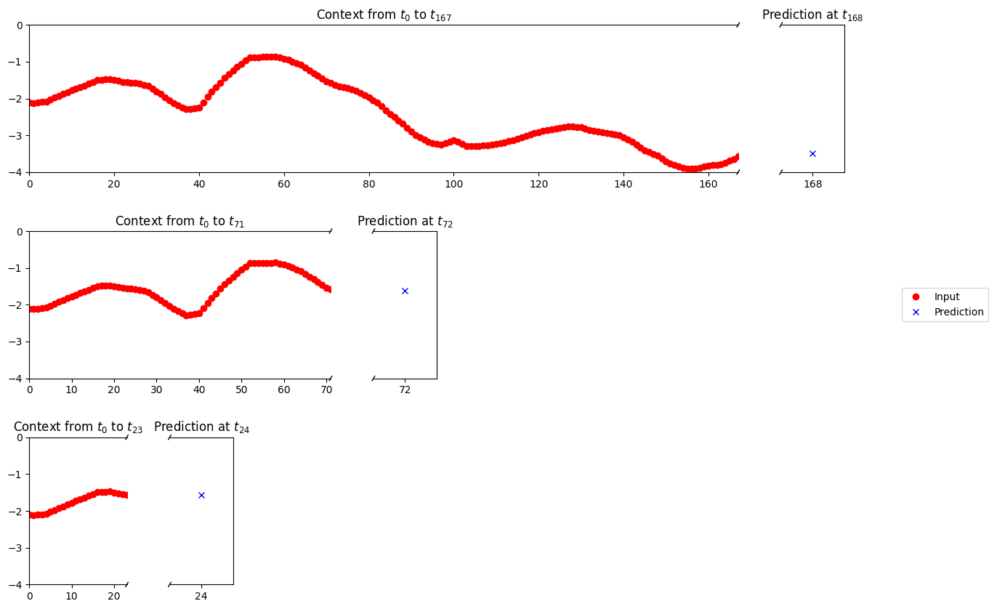
Experiments: Introduction – Context Windows Length

Slide 5
Experiments: Introduction – Context Windows Length

Slide 6
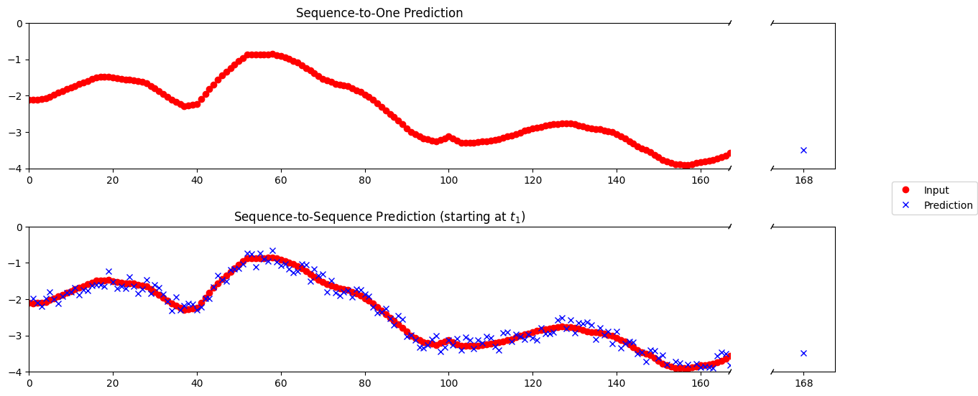
Experiments: Introduction – Prediction Mode

Slide 7
Experiments: Introduction – Prediction Mode

Slide 8
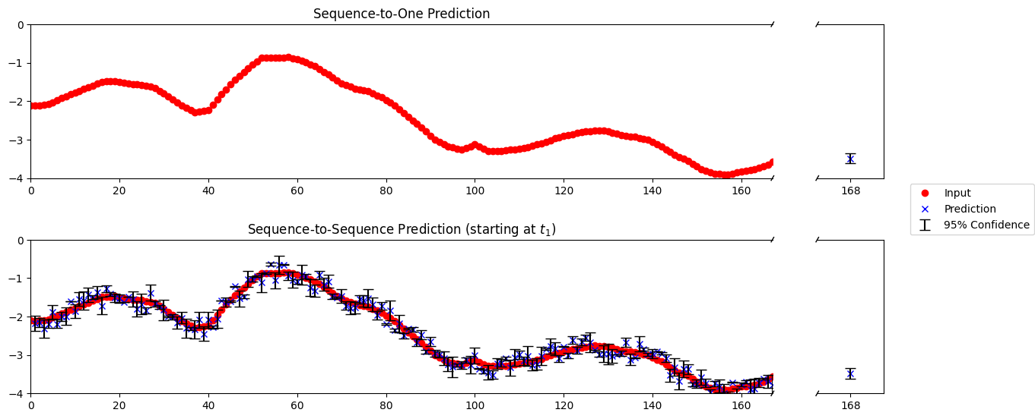
Experiments: Introduction – Distribution Output

Slide 9
Outlook & Discussion
The expectation: NO IMPROVEMENT OF EXISTING NUMERICAL MODELS does not seem to hold
Results remain to be evaluated against baseline models
Persistence (predicted_value = last_observed_value)
FFT-based model (required the know the amplitude and phase per frequency)
Real observations
Auto-regressive behavior of the model needs to be investigated
Additional experiments with prediction_horizon > 1 could further confirm the approach

Slide 10
Outlook & Discussion
The expectation: NO IMPROVEMENT OF EXISTING NUMERICAL MODELS does not seem to hold
Results remain to be evaluated against baseline models
Persistence (predicted_value = last_observed_value)
FFT-based model (required the know the amplitude and phase per frequency)
Real observations
Auto-regressive behavior of the model needs to be investigated
Additional experiments with prediction_horizon > 1 could further confirm the approach
Lessons learned
Data gathering and preparation (especially defining Dataset and LightningDataModule classes) takes most of the time
It gets confusing quickly (Separation of Concerns/Single Responsibility are essential)
Checking and confirming the individual steps of the pipeline is crucial (using assert on dimensions can be helpful)
AI-assisted coding greatly improves implementation speed and helps to consider additional aspects
BUT: it does not make the points above obsolete and limits the learning effect

